Slide 1

Fashion Intelligence Systems
Team Name : Cockroaches
Institute Name: IIT Guwahati

Slide 2

Team members details
Team Name | Cockroaches
Institute Name | IIT Guwahati
Team Members > | 1 (Leader) | 2 | 3
Name | Aman Raj | Mayank Wadhwani | Tushar Bhutada
Batch | 2021 | 2021 | 2021

Slide 3
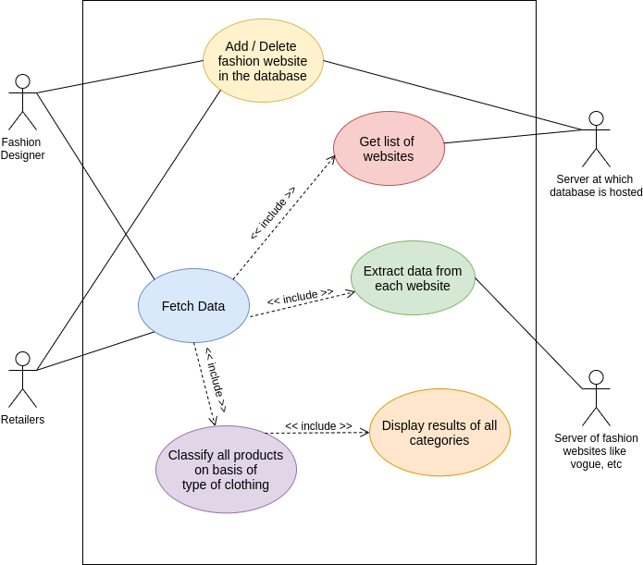
Use Case Diagram

Slide 4
Workflow

Slide 5
Solution statement/ Proposed approach
To build a web portal that will encompass two key entities of the problem statement- Trends extracted from fashion magazines and trending products from e-commerce portals.
In order to make the solution scalable, we intend to put up all the magazine and e-commerce portals in a database(preferably FireBase).
Using web crawlers and backend APIs, we plan to extract all the recent trending fashion products in the same order from the leading portals and magazines.
In a similar way, we will also extract data from e-commerce websites as well in the order of ratings.
Appropriate machine learning models will be applied to the data collected to classify products based on the type of clothing(e.g. t-shirt).
This will be then unified to return a single JSON response and will be displayed on the UI.

Slide 6
Technology Stack
WEB
DATABASE
Google Firebase
Node.js
LIBRARIES
React.js
Tensorflow
HTML, Bootstrap, CSS
Crawler

Slide 7
Design/ solution choices
Database Choice -> Firebase
Pros:
JSON (JavaScript Object Notation) storage implies no barrier between data and objects
Easy Setup
Cons:
Free for only 50,000 reads a day. This is not a big issue since we are using the database to read the list of portals which will be very less in number
Front-end choice -> React.js and Back-end choice -> Node.js
To make the development process simple, we are using JavaScript for both the front-end and back-end which will help in eliminating the time-consuming task of duplicating the code between the browser and server.
Additional Libraries Used ->
TensorFlow: For classification of product fetched from a website into respective categories (like T-shirt)
Crawler: For scraping data from the websites provided in the database.

Slide 8
Limitations
Even though the TensorFlow models have a high accuracy rate, it is not yet perfect. There is always a little degree of inaccuracy present in machine leaning models that can have an impact on the portal’s classification correctness.
Since most of the fashion magazines have their own norms of identifying trends in the market, it is difficult to compare them on a similar basis.

Slide 9
Future Scope
Considering today’s fashion scenario, the machine learning model can be customized to include further categories which are not present in the current model like plazo,etc.
As stated in the limitations section, we can assign priority to websites and based on the priority, we will display the results in order. So if perhaps, the priority of a website X is greater, its contents will be shown on top.
Even though FireBase provides 50,000 reads a day, we can switch to different database on other servers to cater to required needs and have unlimited access.
To get better trends in results, we can read product reviews to understand customer sentiment by applying NLP.

Slide 10


